Slide 1
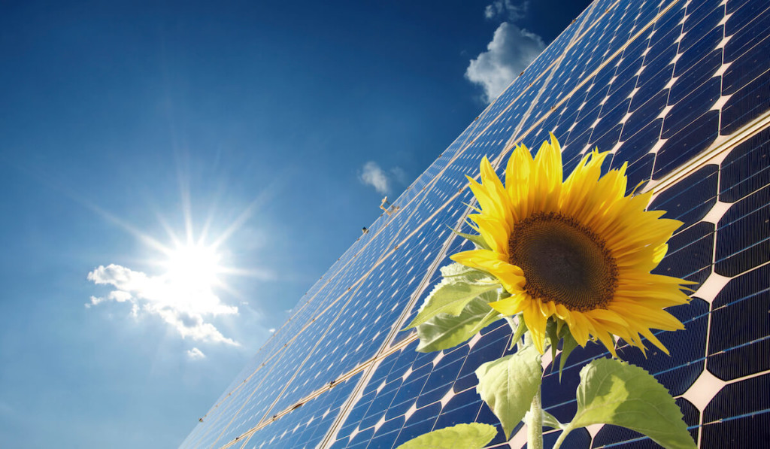
SOLAR SUNFLOWER

Slide 2
PROBLEM STATEMENT
Most of the solar energy is not harnessed by the fixed solar panels.

Slide 3
OBJECTIVE :
Our objective is to make a solar panel which rotates with the direction of sun light.

Slide 4
COMPONENTS
Arduino Uno R3
Servo Motor
Solar Panel
LDR Sensors
Other hardware circuitry
We also require basic C language and Arduino program

Slide 5
WORKING PROCESS
The main theme of the project is based on the
intensity of the light energy.
Firstly, the LDR’s(Light Dependent Resistor ) senses the maximum intensity in the surroundings. The value of intensity is sent to the arduino board.
The arduino board processes the data and sends commands to servo motor.
The servo motors turns the panel according to the direction of maximum intensity of light.

Slide 6
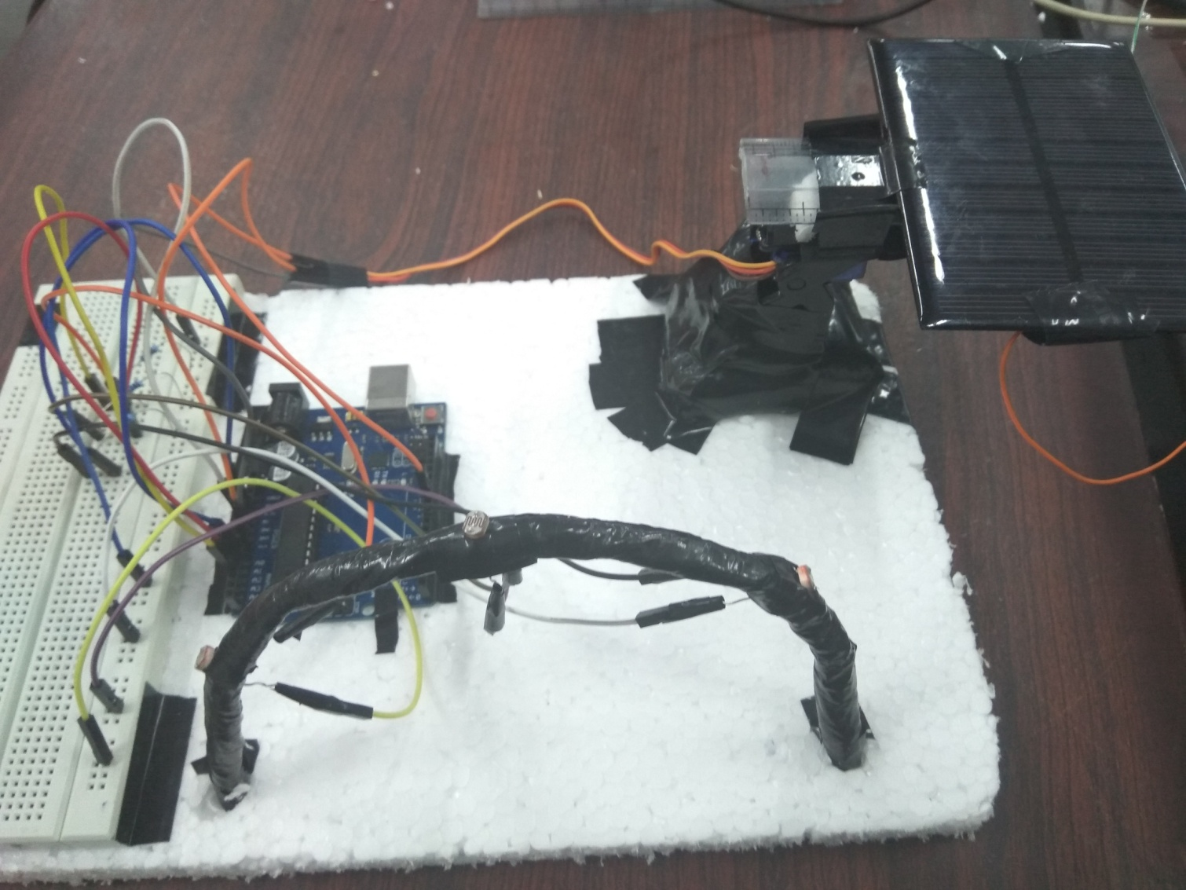
DEMO

Slide 7
BLOCK DIAGRAM
Arduino
LDR Sensor
Servo Motor
Solar Panel
Output

Slide 8
ADVANTAGES
We can harness more energy by this project than the stationary solar panel.
It is available at cheaper cost.
It occupies lesser area and gives more efficient electricity.

Slide 9
THE END

